Slide 1
THE UNIX SYSTEM
sed - Stream Editor
Notes:
CSCI 330 - The UNIX System
NIU - Department of Computer Science

Slide 2
WHAT IS SED?
A non-interactive stream editor
Interprets sed instructions and performs actions
Use sed to:
  Automatically perform edits on file(s)
  Simplify doing the same edits on multiple files
  Write conversion programs

Slide 3
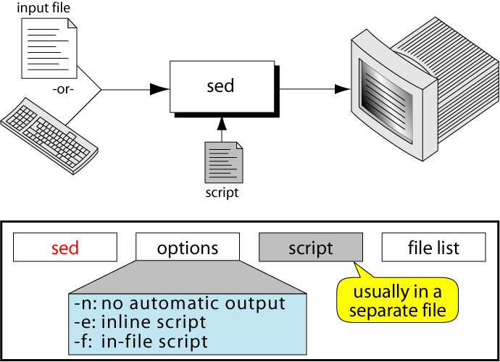
THE SED COMMAND

Slide 4
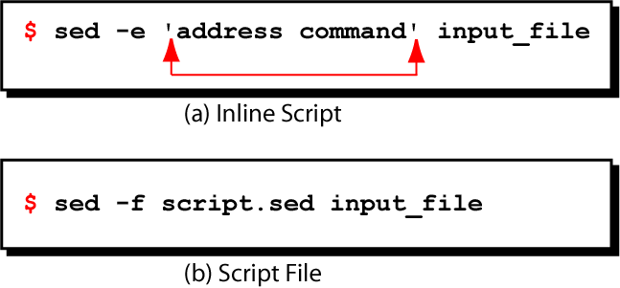
SED COMMAND SYNTAX

Slide 5
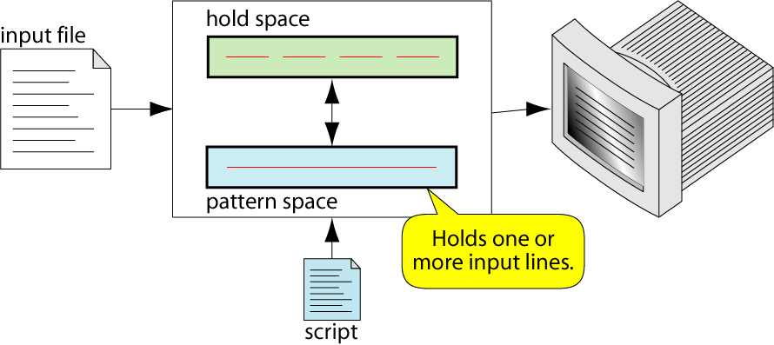
SED OPERATION

Slide 6
HOW DOES SED WORK?
sed reads line of input
  line of input is copied into a temporary buffer called pattern space
  editing commands are applied
    subsequent commands are applied to line in the pattern space, not the original input line
    once finished, line is sent to output
    (unless –n option was used)
  line is removed from pattern space
sed reads next line of input, until end of file
Note: input file is unchanged

Slide 7
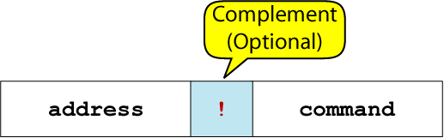
SED INSTRUCTION FORMAT
address determines which lines in the input file are to be processed by the command(s)
  if no address is specified, then the command is applied to each input line
address types:
  Single-Line address
  Set-of-Lines address
  Range address
  Nested address

Slide 8
SINGLE-LINE ADDRESS
Specifies only one line in the input file
  special: dollar sign ($) denotes last line of input file
Examples:
  show only line 3
  sed -n -e '3 p' input-file
  show only last line
  sed -n -e '$ p' input-file
  substitute “endif” with “fi” on line 10
  sed -e '10 s/endif/fi/' input-file

Slide 9
SET-OF-LINES ADDRESS
use regular expression to match lines
  written between two slashes
  process only lines that match
  may match several lines
  lines may or may not be consecutives
Examples:
  sed -e ‘/key/ s/more/other/’ input-file
  sed -n -e ‘/r..t/ p’ input-file

Slide 10
RANGE ADDRESS
Defines a set of consecutive lines
Format:
start-addr,end-addr (inclusive)
Examples:
  10,50 line-number,line-number
  10,/R.E/ line-number,/RegExp/
  /R.E./,10 /RegExp/,line-number
  /R.E./,/R.E/ /RegExp/,/RegExp/

Slide 11
EXAMPLE: RANGE ADDRESS
% sed -n -e ‘/^BEGIN$/,/^END$/p’ input-file
Print lines between BEGIN and END, inclusive
      BEGIN
      Line 1 of input
      Line 2 of input
      Line3 of input
      END
      Line 4 of input
      Line 5 of input
addr1
addr2
These lines are printed

Slide 12
NESTED ADDRESS
Nested address contained within another address
Example:
print blank lines between line 20 and 30
    20,30{
      /^$/ p
    }

Slide 13
ADDRESS WITH !
address with an exclamation point (!):
instruction will be applied to all lines that do not match the address
Example:
print lines that do not contain “obsolete”
sed -e ‘/obsolete/!p’ input-file

Slide 14
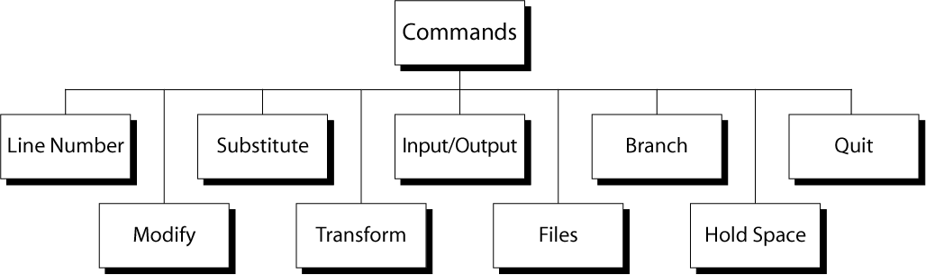
SED COMMANDS

Slide 15
LINE NUMBER
line number command (=) writes the current line number before each matched/output line
Examples:
  sed -e '/Two-thirds-time/=' tuition.data
  sed -e '/^[0-9][0-9]/=' inventory

Slide 16
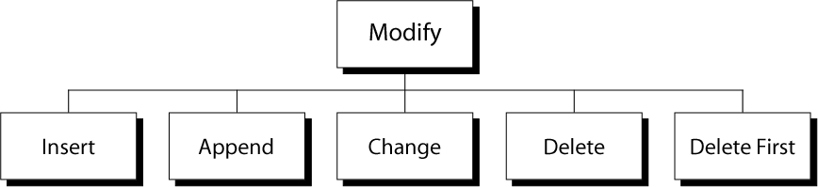
MODIFY COMMANDS
Substitute

Slide 17
INSERT COMMAND: I
adds one or more lines directly to the output before the address:
  inserted “text” never appears in sed’s pattern space
  cannot be used with a range address; can only be used with the single-line and set-of-lines address types
Syntax:
  [address] i\
  text

Slide 18
EXAMPLE: INSERT COMMAND (I)
% cat tuition.insert.sed
1 i\
Tuition List\
% cat tuition.data
Part-time 1003.99
Two-thirds-time 1506.49
Full-time 2012.29
% sed -f tuition.insert.sed tuition.data
Tuition List
Part-time 1003.99
Two-thirds-time 1506.49
Full-time 2012.29
Sed script to insert “Tuition List” as report title before line 1
Input data
Output after applying
the insert command

Slide 19
APPEND COMMAND: A
adds one or more lines directly to the output after the address:
  Similar to the insert command (i), append cannot be used with a range address.
  Appended “text” does not appear in sed’s pattern space.
Syntax:
  [address] a\
  text

Slide 20
EXAMPLE: APPEND COMMAND (A)
% cat tuition.append.sed
a \
--------------------------
% cat tuition.data
Part-time 1003.99
Two-thirds-time 1506.49
Full-time 2012.29
% sed -f tuition.append.sed tuition.data
Part-time 1003.99
--------------------------
Two-thirds-time 1506.49
--------------------------
Full-time 2012.29
--------------------------
Sed script to append
dashed line after
each input line
Input data
Output after applying
the append command

Slide 21
CHANGE COMMAND: C
replaces an entire matched line with new text
accepts four address types:
  single-line, set-of-line, range, and nested addresses.
Syntax:
  [address1[,address2]] c\
  text

Slide 22
EXAMPLE: CHANGE COMMAND (C)
% cat tuition.change.sed
1 c\
Part-time 1100.00
% cat tuition.data
Part-time 1003.99
Two-thirds-time 1506.49
Full-time 2012.29
% sed -f tuition.change.sed tuition.data
Part-time 1100.00
Two-thirds-time 1506.49
Full-time 2012.29
Sed script to change
tuition cost from
1003.99 to 1100.00
Input data
Output after applying
the change command

Slide 23
DELETE COMMAND: D
deletes the entire pattern space
  commands following the delete command are ignored since the deleted text is no longer in the pattern space
Syntax:
  [address1[,address2]] d

Slide 24
EXAMPLE: DELETE COMMAND (D)
Remove part-time data from “tuition.data” file
% cat tuition.data
Part-time 1003.99
Two-thirds-time 1506.49
Full-time 2012.29
% sed –e '/^Part-time/d' tuition.data
Two-thirds-time 1506.49
Full-time 2012.29
Input data
Output after applying delete command

Slide 25
SUBSTITUTE COMMAND (S)
Syntax:
[addr1][,addr2] s/search/replace/[flags]
replaces text selected by search string with replacement string
search string can be regular expression
flags:
  global (g), i.e. replace all occurrences
  specific substitution count (integer), default 1

Slide 26
REGULAR EXPRESSIONS: USE WITH SED
Metacharacter | Description/Matches…
. | Any one character, except new line
* | Zero or more of preceding character
^ | A character at beginning of line
$ | A character at end of line
\char | Escape the meaning of char following it
[ ] | Any one of the enclosed characters
\( \) | Tags matched characters to be used later
x\{m\} | Repetition of character x, m times
\< | Beginning of word
\> | End of word

Slide 27
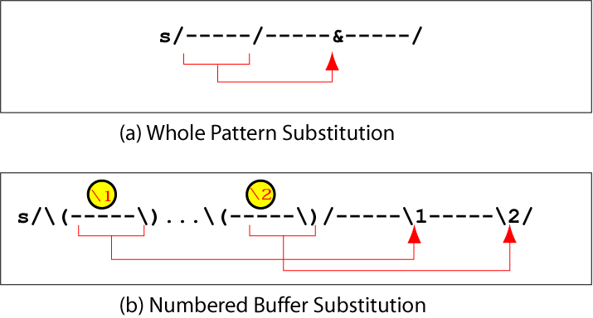
SUBSTITUTION BACK REFERENCES

Slide 28
EXAMPLE: REPLACEMENT STRING &
$ cat datafile
Charles Main 3.0 .98 3 34
Sharon Gray 5.3 .97 5 23
Patricia Hemenway 4.0 .7 4 17
TB Savage 4.4 .84 5 20
AM Main Jr. 5.1 .94 3 13
Margot Weber 4.5 .89 5 9
Ann Stephens 5.7 .94 5 13
$ sed -e ‘s/[0-9][0-9]$/&.5/’ datafile
Charles Main 3.0 .98 3 34.5
Sharon Gray 5.3 .97 5 23.5
Patricia Hemenway 4.0 .7 4 17.5
TB Savage 4.4 .84 5 20.5
AM Main Jr. 5.1 .94 3 13.5
Margot Weber 4.5 .89 5 9
Ann Stephens 5.7 .94 5 13.5

Slide 29
EXAMPLE: BACK REFERENCE
$ cat filedata
/home/ux/user/z156256
/home/ux/user/z056254
/home/lx/user/z106253
/home/ux/user/z150252
/home/mp/user/z056254
/home/lx/user/z106253
$ sed -e 's,/home/\(..\)/user/\(z[0-9]\{6\}\),/usr/\2/\1,g' filedata
/usr/z156256/ux
/usr/z056254/ux
/usr/z106253/lx
/usr/z150252/ux
/usr/z056254/mp
/usr/z106253/lx

Slide 30
TRANSFORM COMMAND (Y)
Syntax:
[addr1][,addr2]y/a/b/
  translates one character 'a' to another 'b'
  cannot use regular expression metacharacters
  cannot indicate a range of characters
  similar to “tr” command
Example:
  $ sed -e ‘1,10y/abcd/wxyz/’ datafile
Must have same number of characters

Slide 31
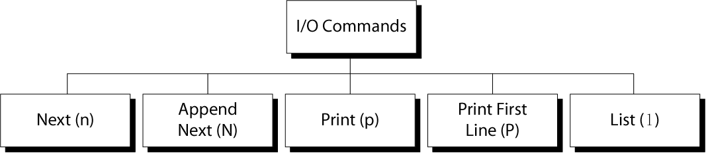
SED I/O COMMANDS

Slide 32
INPUT (NEXT) COMMAND: N AND N
Forces sed to read the next input line
  Copies the contents of the pattern space to output
  Deletes the current line in the pattern space
  Refills it with the next input line
  Continue processing
N (uppercase) Command
  adds the next input line to the current contents of the pattern space
  useful when applying patterns to two or more lines at the same time
Notes:
The sed Utility
Copyright Department of Computer Science, Northern Illinois University,2004
Clears the pattern space before inputting the next line

Slide 33
OUTPUT COMMAND: P AND P
Print Command (p)
  copies the entire contents of the pattern space to output
  will print same line twice unless the option “–n” is used
Print command: P
  prints only the first line of the pattern space
  prints the contents of the pattern space up to and including a new line character
  any text following the first new line is not printed

Slide 34
LIST COMMAND (L)
The list command: l
  shows special characters (e.g. tab, etc)
The octal dump command (od -c) can be used to produce similar result

Slide 35
HOLD SPACE
temporary storage area
used to save the contents of the pattern space
4 commands that can be used to move text back and forth between the pattern space and the hold space:
h, H
g, G

Slide 36
HOLD COMMANDS: H AND H
The lowercase hold (and replace) command (h) copies the current contents of the pattern space to the hold space and replaces any text currently in the hold space
The uppercase hold (and append) command (H) appends the current contents of the pattern space to the hold space

Slide 37
THE GET COMMANDS: G AND G
The lowercase get (and replace) command (g) copies the text in the hold space to the pattern space and replaces any text currently in the pattern space
The uppercase get (and append) command (G) appends the current contents of the hold space to the pattern space

Slide 38
THE ‘H’ AND ‘G’ COMMANDS
Syntax: [addr1][,addr2]h
  copies the contents of the pattern space to a hold space; replaces any text currently in the hold space
Syntax: [addr1][,addr2]G
  gets what was in the hold space and copies it into the pattern space, appending to what was there
h
Pattern Space
(append)
Hold Space
G

Slide 39
EXAMPLE: THE ‘H’ AND ‘G’ COMMANDS
% sed -e ‘/northeast/h’ -e ‘$G’ datafile
northwest NW
western WE
southwest SW
southern SO
southeast SE
eastern EA
northeast NE
north NO
central CT
northeast NE
% cat datafile
northwest NW
western WE
southwest SW
southern SO
southeast SE
eastern EA
northeast NE
north NO
central CT

Slide 40
THE ‘G’ COMMAND
Syntax: [addr1][,addr2]g
  Gets what was in the hold space and copies it into the pattern space, overwriting what was there
h
Pattern Space
(overwrite)
Hold Buffer
g

Slide 41
EXAMPLE: THE ‘H’ AND ‘G’ COMMANDS
% sed -e ‘/northeast/h’ -e ‘$g’ datafile
northwest NW
western WE
southwest SW
southern SO
southeast SE
eastern EA
northeast NE
north NO
northeast NE
% cat datafile
northwest NW
western WE
southwest SW
southern SO
southeast SE
eastern EA
northeast NE
north NO
central CT

Slide 42
FILE COMMANDS
allows to read and write from/to file while processing standard input
read: r command
write: w command

Slide 43
READ FILE COMMAND
Syntax: r filename
  queue the contents of filename to be read and inserted into the output stream at the end of the current cycle, or when the next input line is read
    if filename cannot be read, it is treated as if it were an empty file, without any error indication
  single address only

Slide 44
WRITE FILE COMMAND
Syntax: w filename
  Write the pattern space to filename
  The filename will be created (or truncated) before the first input line is read
  all w commands which refer to the same filename are output through the same FILE stream

Slide 45
BRANCH COMMAND (B)
Change the regular flow of the commands in the script file
Syntax: [addr1][,addr2]b[label]
  Branch (unconditionally) to ‘label’ or end of script
  If “label” is supplied, execution resumes at the line following :label; otherwise, control passes to the end of the script
Branch label
  :mylabel
Can be up to 7 characters
Must be on a line by itself
Must begin with a colon
No spaces after it and after the colon

Slide 46
EXAMPLE: BRANCH (B) COMMAND
Example:
If the string ‘soph’ is found on a line, write the matched line to a file called “soph.students”; otherwise, write unmatched lines to a file called ‘others’:
/soph/b save
w others
b
:save
w soph.students

Slide 47
EXAMPLE: THE QUIT (Q) COMMAND
Syntax: [addr]q
  Quit (exit sed) when addr is encountered.
Example: Display the first 50 lines and quit
  % sed -e ’50q’ datafile
  Same as:
  % sed -n -e ‘1,50p’ datafile
  % head -50 datafile
Notes:
The sed Utility
Copyright Department of Computer Science, Northern Illinois University,2004

